Slide 1

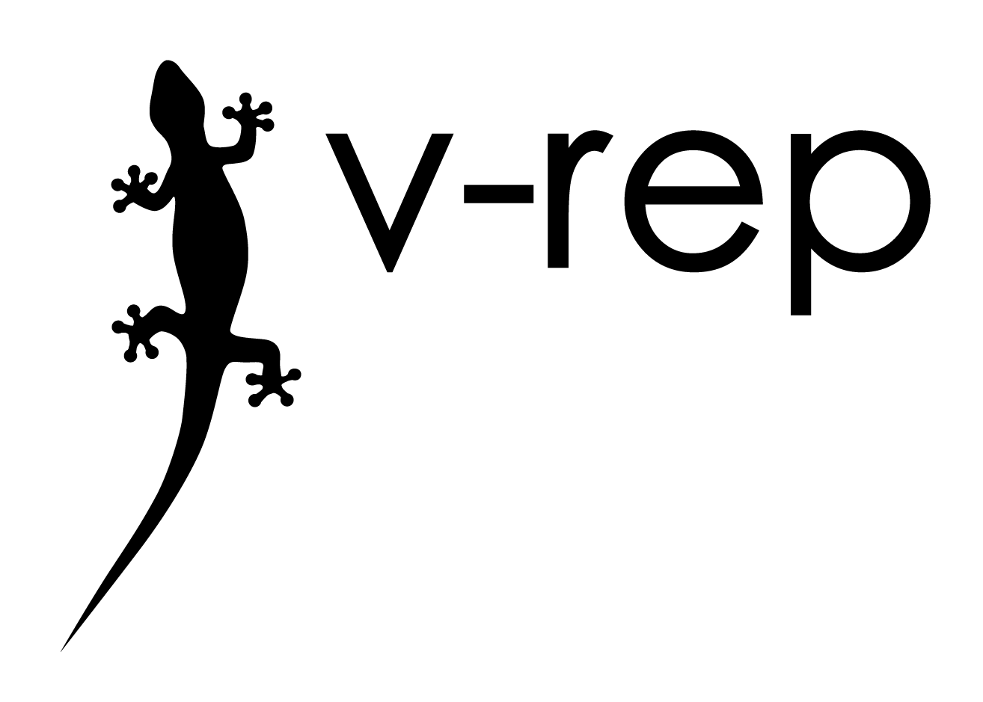
Robotic Simulator Controller

Slide 2
Overview
V-REP, scenes, scripts and controlling objects remotely
➔ Tobias Bauer
Development problem and Server adapter solution
➔ Pongwanit Jeaperapong
App and hardware
➔ Rui Choo

Slide 3
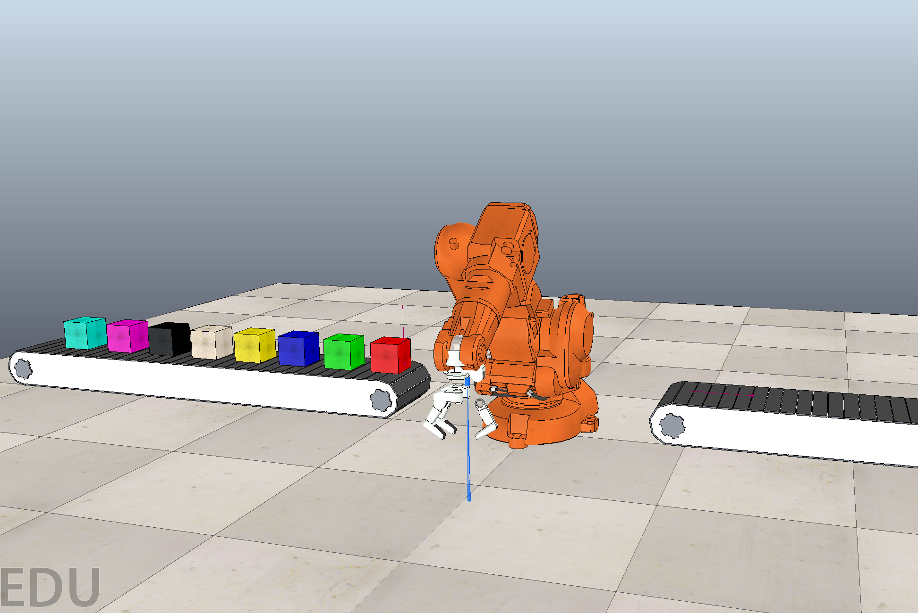
The Scene
IRB_140 Robot
Gripper
Vision Sensor
Blocks
Conveyor belts
Conveyor belt sensors

Slide 4
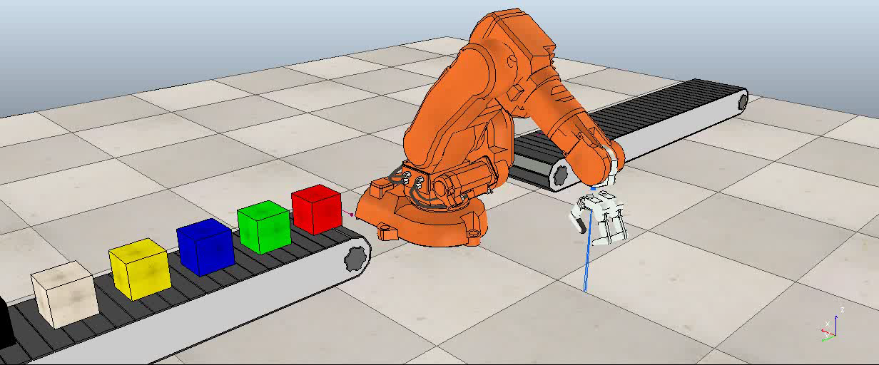
The Task

Slide 5
Simulation scripts
Written in LUA
Main Script
Necessary for Simulation to run
Handles all calls to child scripts
Child scripts
Attached to models
Non-threaded/threaded child scripts
➔recommended to use non-threaded:
actuation
sensing
initialisation
restoration

Slide 6
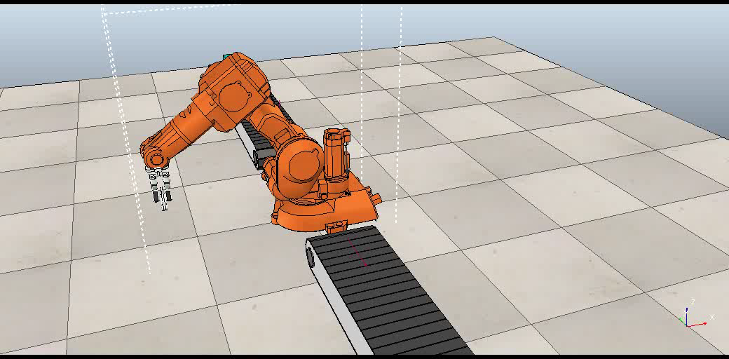
Controlling the robot
IRB 140 child script (pseudo code)
Java Program
Set signal
Initialisation -------------------------
signal move = 0
-----------------------------------------
Actutation ---------------------------
If signal “move“ != 0
rotate(signal move)
-----------------------------------------
function rotate (velocity)----------
jointOrientation += velocity
-----------------------------------------

Slide 7
Introducing V-REP Remote API
Want to develop application that interface with V-REP ?
Remote API library is available in
C++, Python, Java, Matlab, Octave, Lua, Urbi
Source code available for self compiling
Doucmentation available in V-REP website
http://www.coppeliarobotics.com/helpFiles/en/apiFunctions.htm

Slide 8
libremoteApiJava native library problem
.dll for Windows
.so for Linux
.dylib for macOS
All for x86-64 CPU architecture
libremoteApiJava.so provided do not run on Android ARM
“java.lang.UnsatisfiedLinkError”

Slide 9
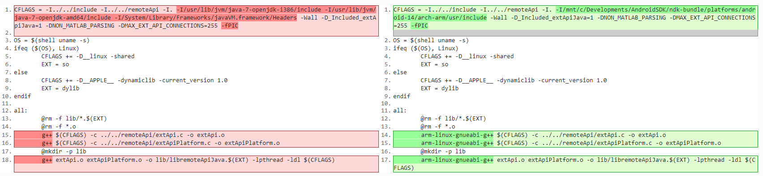
Trying to recompile for ARM
Installing arm-linux-gnueabi-g++
Editing makefile
Change from gcc++ to arm-linux-gnueabi-g++ and
Change include directory from OpenJDK to Android NDK ARM
Original Modified

Slide 10
Trying to recompile for ARM
“java.lang.UnsatisfiedLinkError: dlopen failed: library "libpthread.so.0" not found”
extApiPlatform.c line 50: #include <pthread.h>
Android has no libpthread.so.0
Desktop Linux has libpthread.so.0

Slide 11






Server Adapter Solution
2.Translate command to V-REP API call
3.Send V-REP API call
4.Robot moves
1.Send custom command
6.Forward related data
5.Send related data

Slide 12
Example of Translation
“SIMULATION\n1\n” -> vrep.simxStartSimulation
“SIMULATION\n2\n” -> vrep.simxPauseSimulation
“MOVEMENTDATA\n*number*\n*number*\n” ->
vrep.simxSetFloatSignal(…,”rotate”,…) and vrep.simxSetFloatSignal(…,” moveUpDown”,…)
“MOVEMENTDATAVIABUTTON\n*string* \n” ->
vrep.simxSetFloatSignal(…,”rotate”,…) or vrep.simxSetFloatSignal(…,” moveUpDown”,…)
“GRIPPERDATA\n*number*\n” ->
vrep.simxSetFloatSignal(…,” closeGripper”,…)

Slide 13
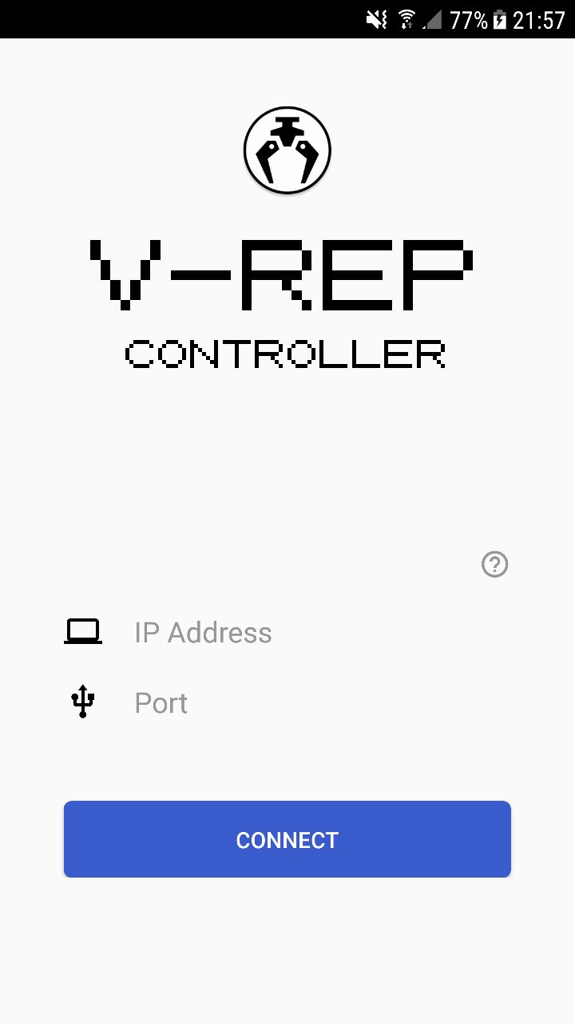

Slide 14
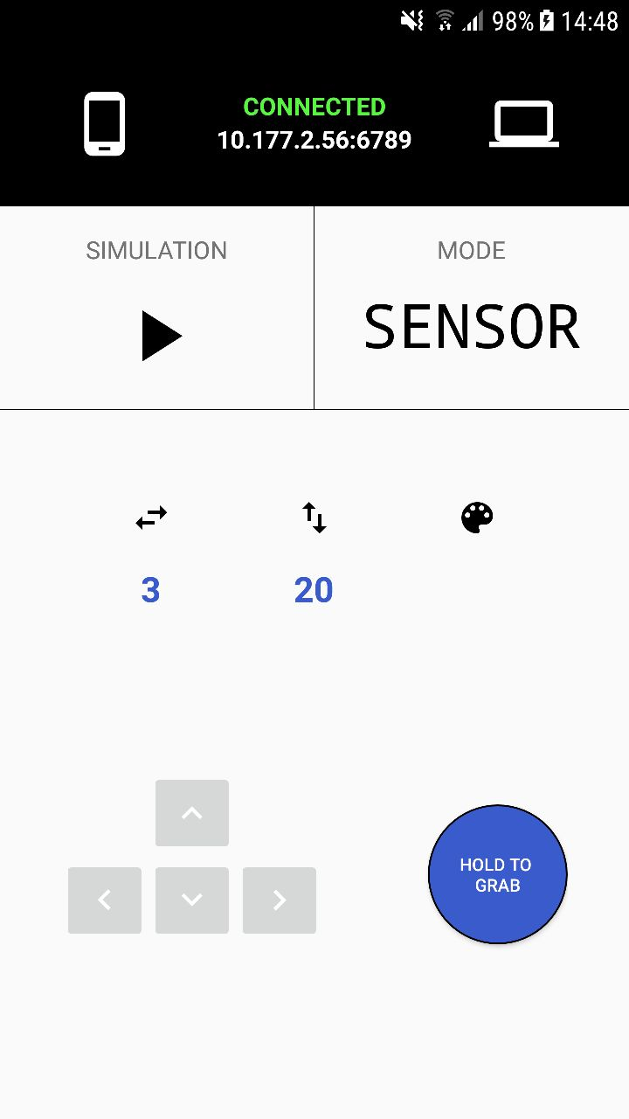

Slide 15
Android Sensors
Accelerometer
Gyroscope
Rotation Vector

Slide 16
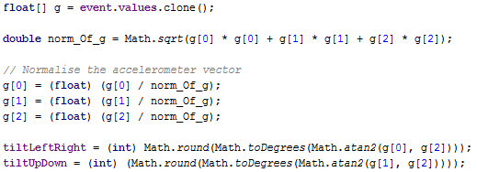
Android Sensors
Accelerometer
Available in virtually all devices
Uses much less battery than the gyroscope

Slide 17
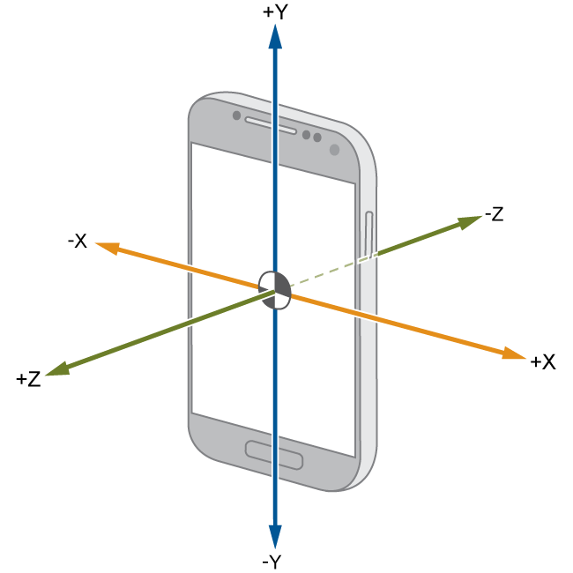

Slide 18
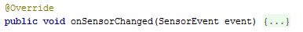

Slide 19
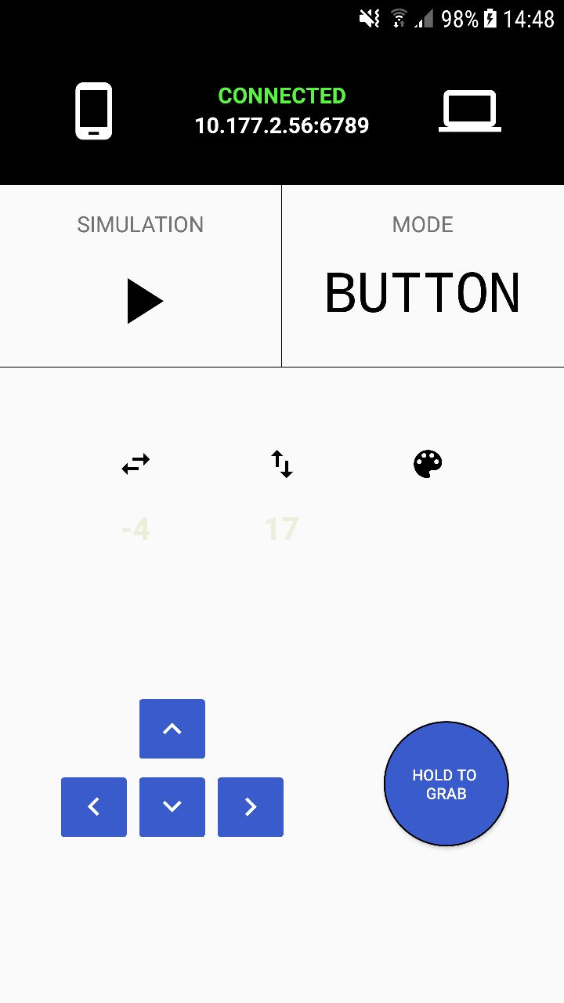

Slide 20
What is V-REP?
Robot simulator with IDE
Objects controlled via embedded script over
plugin
ROS node
custom solution
remote API client
Controllers can be written in
C/C++
Python
Matlab
Octave
Java
Lua

Slide 21
Thank you for your attention

